Slide 1
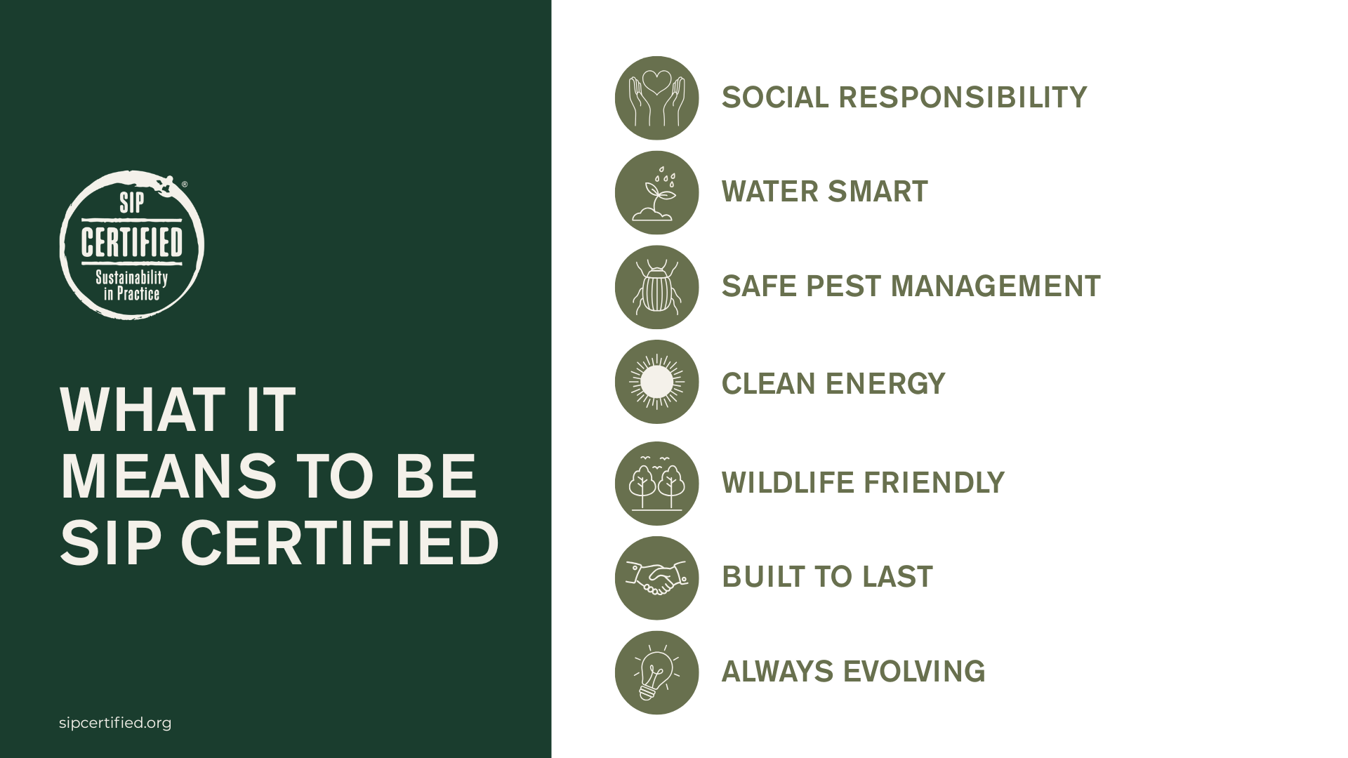

Slide 2
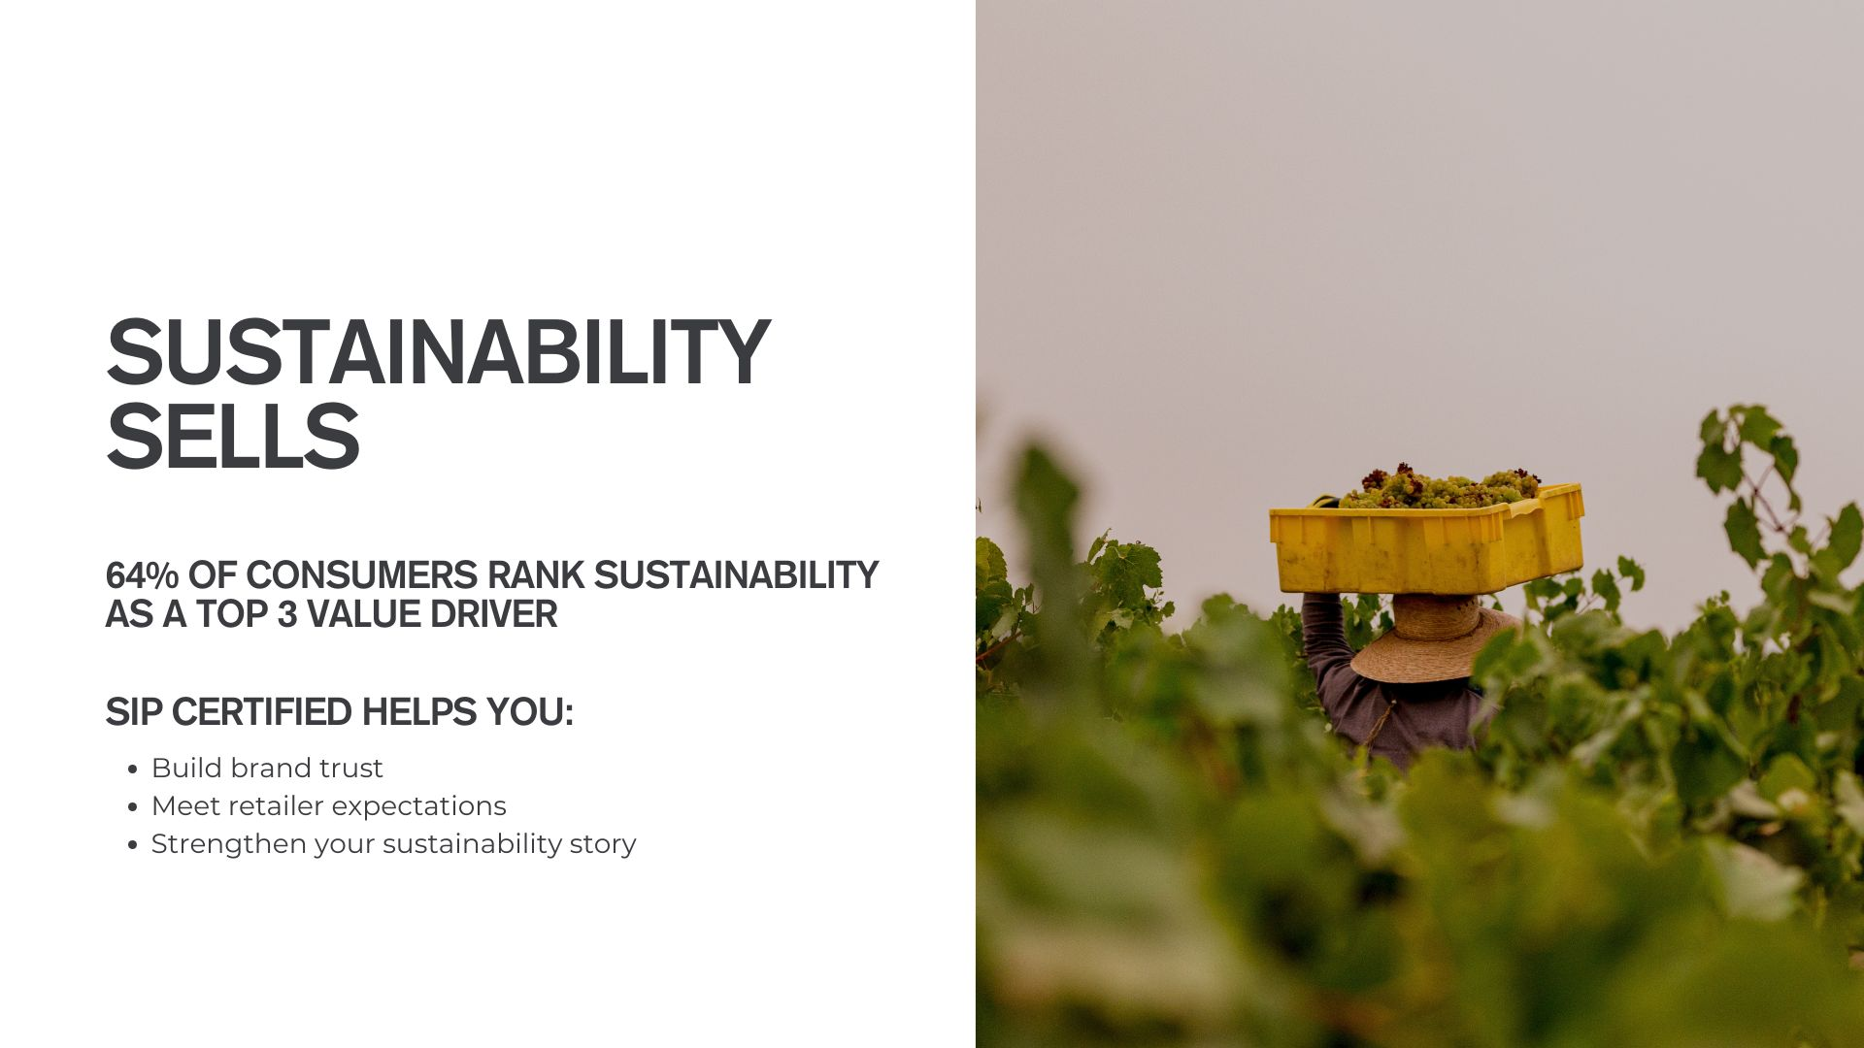

Slide 3
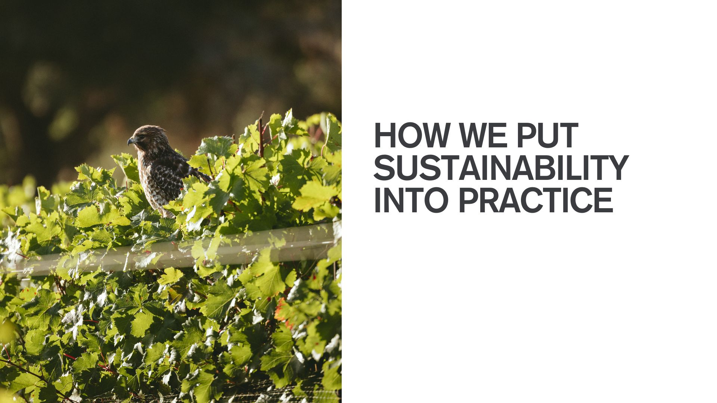
customize text here
(eg) graze animals to reduce herbicide use
(eg) 100% solar powered winery operations

