Slide 1
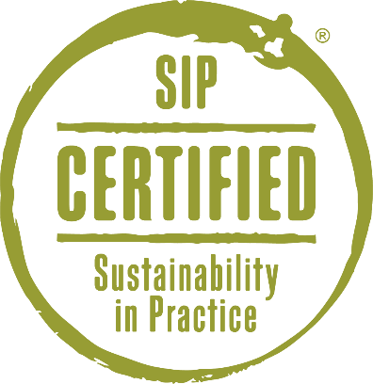
Jeopardy

Slide 2
TO PLAY:
Watch a Category video
Sustainability
People
Planet
Prosperity
Marketing
Launch SIP Certified Jeopardy into full screen mode
On slide #3, click a number under the Category you watched a video for
Click or hit Enter twice for the question
Click or hit Enter twice for the answer
Click the blue arrow to go back to the Categories
Repeat from #3
Have fun and share your new trivia with your customers!

Slide 3
Sustainability
People
Planet
Prosperity
Marketing
10
10
10
10
10
20
20
20
20
20
30
30
30
30
30
40
40
40
40
40
50
50
50
50
50

Slide 4
Sustainability – 10 Points
QUESTION:
What does the S. I. P. stand for in SIP Certified?
ANSWER:
What is Sustainability in Practice.

Slide 5
Sustainability – 20 Points
QUESTION:
What are the three P’s of sustainability?
ANSWER:
What is People, Planet, Prosperity.

Slide 6
Sustainability – 30 Points
QUESTION:
SIP Certified’s rules are a___________. As science, technology, and research developments become available the program evolves with the expertise of a Technical Committee peer review.
ANSWER:
What is living document.

Slide 7
Sustainability – 40 Points
QUESTION:
What certifications addresses habitat conservation, soil quality, and biodiversity like SIP Certified, but do not address air quality, social equity, and business stability?
ANSWER:
What are Organic and Biodynamic.

Slide 8
Sustainability – 50 Points
QUESTION:
What process do vineyards and wineries go through each year to verify their sustainable practices?
ANSWER:
What is third-party inspection/audit.

Slide 9
People – 10 Points
QUESTION:
How many hours of continuing education are required each year for SIP Certified participants?
ANSWER:
What is 20 hours.

Slide 10
People – 20 Points
QUESTION:
What are bonuses, retirement plans, and medical insurance premiums examples of?
ANSWER:
What is worker benefits.

Slide 11
People – 30 Points
QUESTION:
What includes:
Salary, Benefits, and Incentives
Employee Orientation
Ongoing Training
Employee Safety Policies & Practices
ANSWER:
What is Employee Handbook.

Slide 12
People – 40 Points
QUESTION:
What does every worker need before working in a confined space or driving a tractor?
ANSWER:
What is safety training.

Slide 13
People – 50 Points
QUESTION:
Participation in community conversations and providing notification of major changes to farming practices are all part of what?
ANSWER:
What is a Neighbor and Community Communication Plan.

Slide 14
Planet – 10 Points
QUESTION:
What nests in a box and is used as a natural form of pest control for small rodents?
ANSWER:
What is a barn owl.

Slide 15
Planet – 20 Points
QUESTION:
What should be monitored monthly to reduce energy and water use?
ANSWER:
What is utility bills or utility usage.

Slide 16
Planet – 30 Points
QUESTION:
What is grown between the vine rows to reduce erosion and filter storm runoff?
ANSWER:
What is a cover crop.

Slide 17
Planet – 40 Points
QUESTION:
SIP Certified prevents the use of high risk ________.
ANSWER:
What are pesticides.

Slide 18
Planet – 50 Points
QUESTION:
What farming practice uses knowledge of pest lifecycles, beneficial insects, natural predators, pest prevention, and spot spraying when needed?
ANSWER:
What is Integrated Pest Management.

Slide 19
Prosperity – 10 Points
QUESTION:
What can you do with oil containers, oil filters, tires, batteries and pesticide containers?
ANSWER:
What is recycle.

Slide 20
Prosperity – 20 Points
QUESTION:
What do you use to estimate income and expenditures for a set period of time?
ANSWER:
What is a budget.

Slide 21
Prosperity – 30 Points
QUESTION:
Brix, pH, and TA are all measures of what?
ANSWER:
What is fruit quality.

Slide 22
Prosperity – 40 Points
QUESTION:
When things are bought based on specific criteria including price, dependability, and environmental considerations, the company has a what?
ANSWER:
What is a Purchasing Policy.

Slide 23
Prosperity – 50 Points
QUESTION:
How do you assess the effects of vineyard practices on wine quality?
ANSWER:
What are vineyard trials.

Slide 24
Marketing – 10 Points
QUESTION:
What can be used on wine point of sale materials including tasting room notes, bottle neckers, brochures, and websites?
ANSWER:
What is the SIP Certified seal.

Slide 25
Marketing – 20 Points
QUESTION:
When is Earth Month?
ANSWER:
What is April.

Slide 26
Marketing – 30 Points
QUESTION:
Where can you find point of sales materials, logos, talking points, and presentations to help you share your sustainable practices?
ANSWER:
What is www.SIPcertified.org/Tools.

Slide 27
Marketing – 40 Points
QUESTION:
Wines with the SIP Certified seal on the label need to be made with what percentage of certified fruit?
ANSWER:
What is 85%.

Slide 28
Marketing – 50 Points
QUESTION:
A study by The Guardian showed that 76% of the public believe independent, third-party __________ is the best way to verify a product’s social or environmental claims.
ANSWER:
What is certification.

